Slide 1
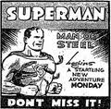
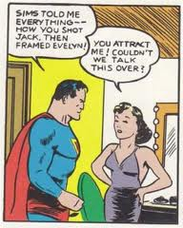
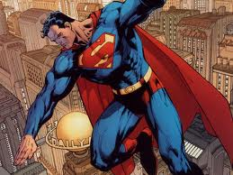
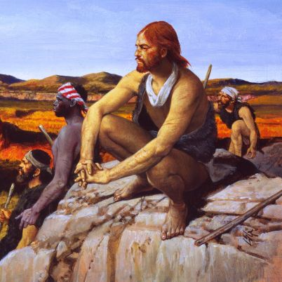
Cartoon Strip Assignment
Write a cartoon strip for each of the explorers below
1. Alonzo Alvarez de Pineda 1st full paragraph top of pg 76.
2. Cortez Conquers Mexico pg 72
3. The Navarez Expedition pgs 76-77
Finish 1-3 Today or its HW
Finish 4-7 Tomorrow or its HW
4. Alvar Nunez Cabeza de Vaca pgs 77-79
5. Francisco Vasquez de Coronado & The Search for the Seven Cities of Gold pg 79-81
6. Hernando de Soto pg 83 (EXTRA CREDIT)
In making your cartoon be ready to show in your work:
-Read each story twice first
-Break down the story into its main details, creating a new cartoon cell for each detail .
-Cartoons should tell the explorers story without losing much detail. The more detailed your cartoon the better the grade.
-Use images, word bubbles and narration text, vocabulary.
-What was the explorer’s mission and who sent them.
-Who was involved? (Native Tribes/Other Persons)
-What was the outcome? What happened? Was the mission completed? How did it end?

