Slide 1
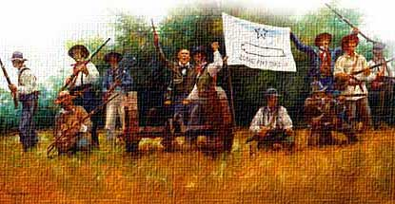
A. Battle of Gonzalez, October 2, 1835
B. General Cos sent an army patrol to Gonzalez to seize their cannon . When the Mexican patrol reached Gonzales, Alcalde Andrew Ponton refused to give up the cannon without written orders. The patrol withdrew awaiting the written order. The Texans buried the cannon and prepare for the soldiers’ return. When the Mexican soldiers returned about 160 settlers elected J. H. Moore as their leader and dug up the cannon. Near the cannon they flew a flag with the words. Come and Take It.
Lieutenant Francisco Castañeda led 100 Mexican soldiers to Gonzales to take the cannon. They arrived on September 29 and, seeing the armed Texans, waited on the other side of the Guadalupe River. On October 2 Moore’s men crossed the river and fired the cannon at the Mexican soldiers who retreated to San Antonio.
C. This battle showed that the Texans were becoming more defiant toward the Mexican government and more willing to use military force if necessary.

Slide 2
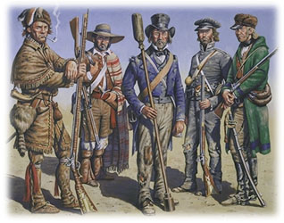
2. A. The Army of the People, October 1835
In October of 1835 300 Texans at Gonzales formed the Army of the People and elected Stephen Austin as their leader. The Army of the People marched to San Antonio to attack General Cos. Along the way they were joined by other Texans growing to a force of almost 600 men. When they reached San Antonio the Army began a month long siege of San Antonio waiting for General Cos to surrender.
C. General Cos and the Mexican Army retreated into San Antonio surrounded by the Army of the People.

Slide 3
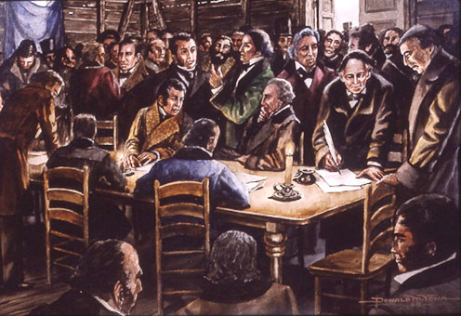
3. A. The Consultation, November 1835
B. On November 4, 1835 delegates (representatives) from the different Texas colonies meets in San Felipe to discuss what Texas should do. Members of the War Party wanted to declare independence from Mexico. Members of the Peace Party wanted to stay loyal to Mexico but fight Santa Anna for their rights under the Constitution of 1824.
On November 6th the Consultation decided not to declare independence and the next day they approved the Declaration of the People of Texas in General Convention. This document declared that the Texans were fighting for the Constitution of 1824 and encouraged other Mexicans to join them. It also set up a temporary or Provisional Government for Texas with Henry Smith as Governor.
Stephen Austin, Branch Archer, and William Wharton were sent to the US to get men and money to fight. Sam Houston was appointed Commander of the Texas Army
They agreed to meet on March 1 to reconsider independence.
C. No Part C needed

Slide 4
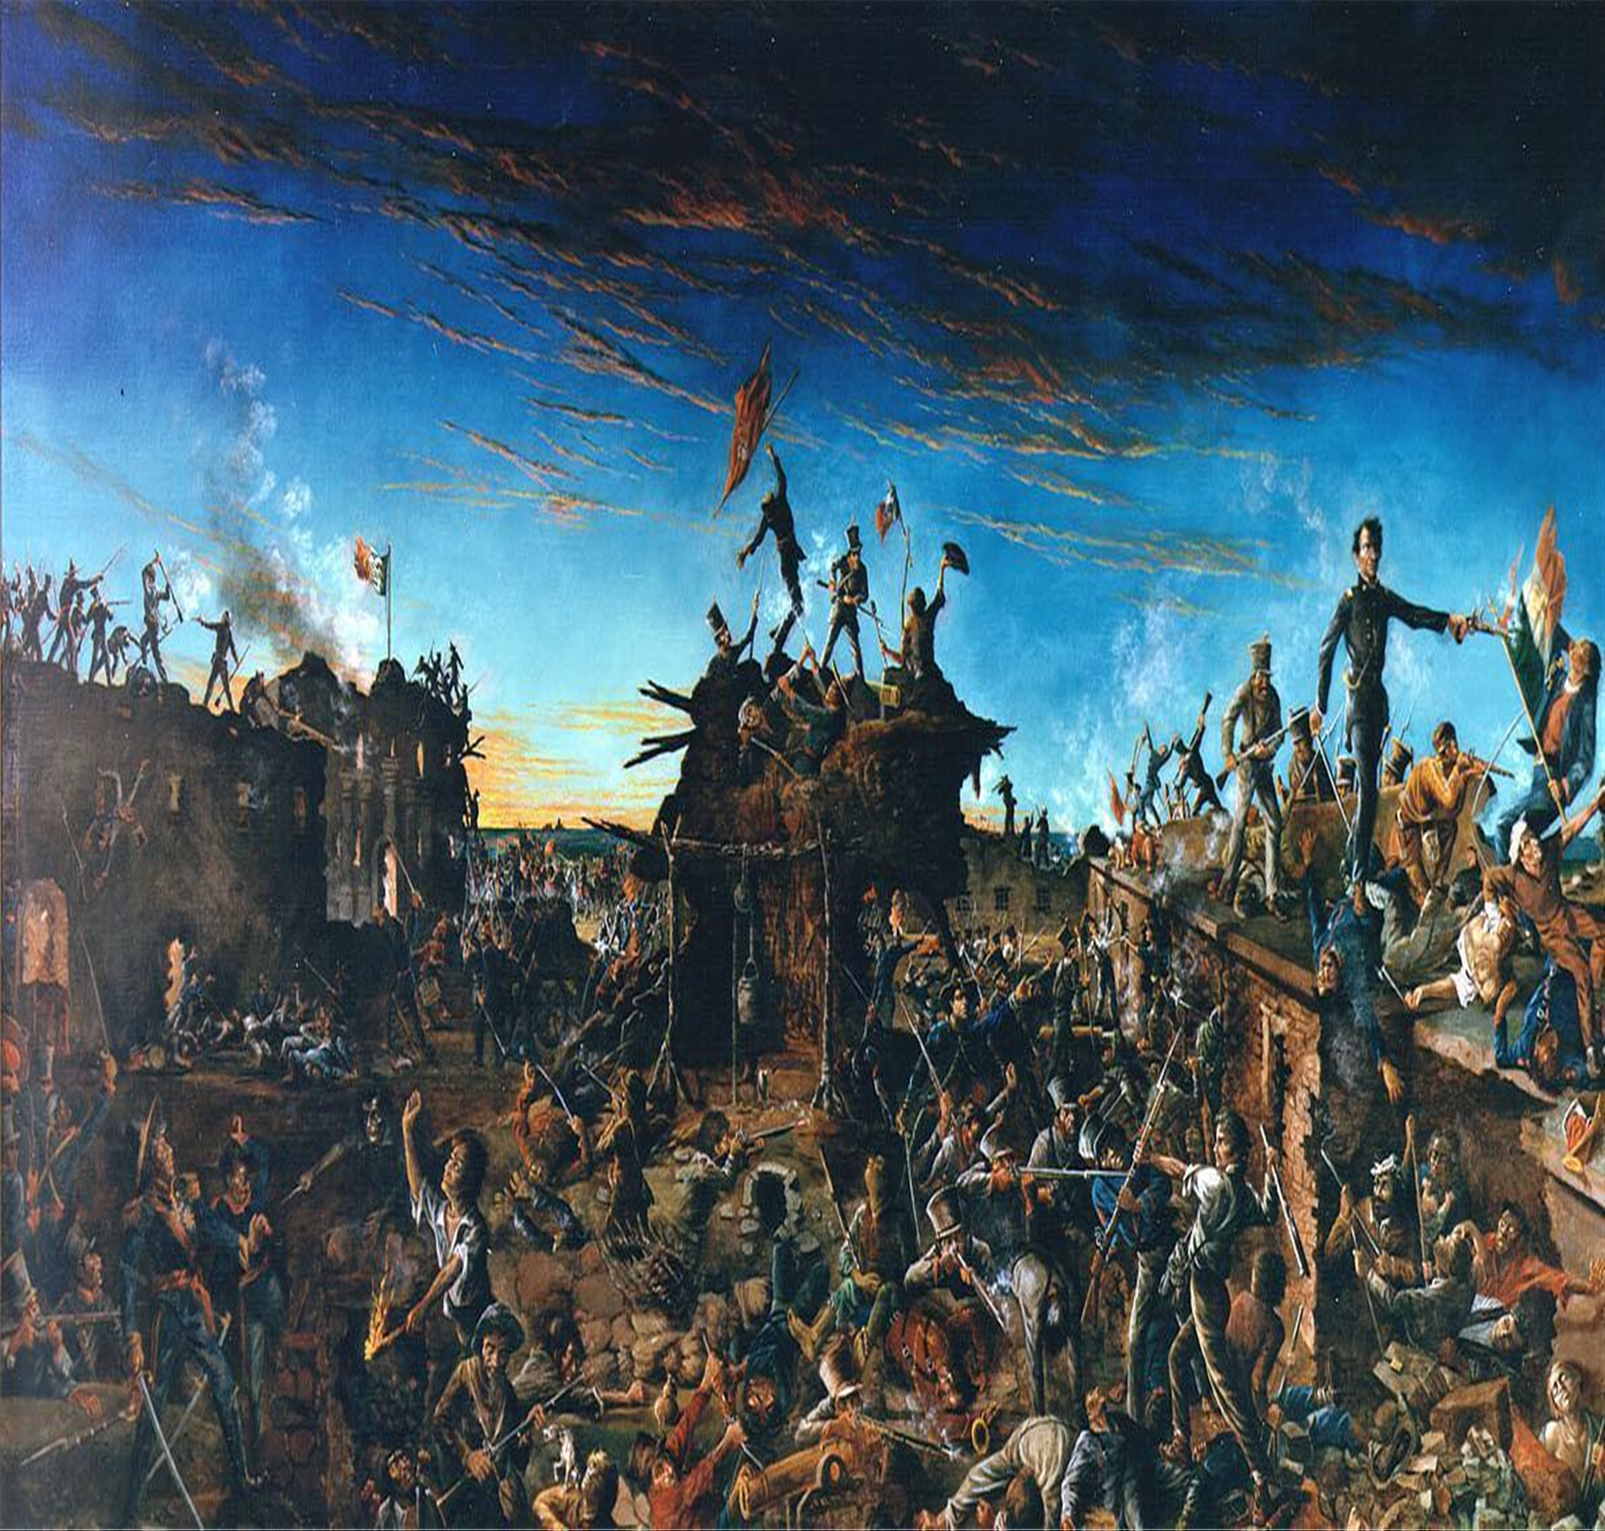
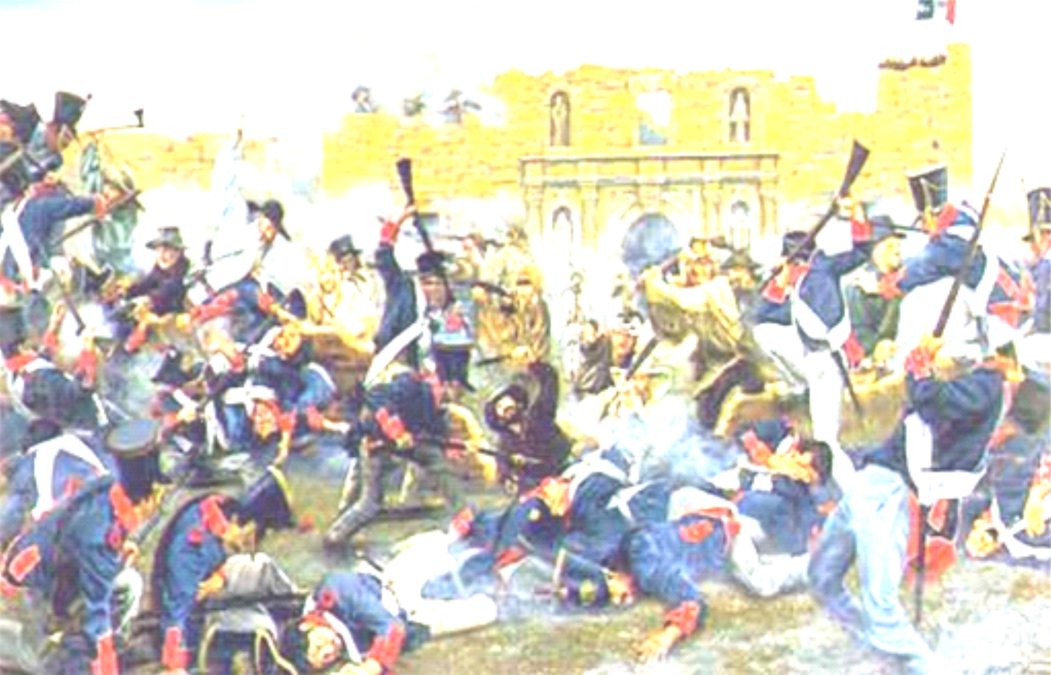
5. A. The Siege & Battle of The Alamo February 23 – March 6 1836
B. -In 1836 a Mexican force of about 2000 to 4000 men commanded by Santa Anna surrounded The Alamo in San Antonio. The siege (non-troop cannon attack) lasts 13 days.
- The Texan Forces—189 were led by Colonel William Barrett Travis, and Jim Bowie is too. But is sick. -Davey Crockett famous US folk hero fights & dies in this battle -Travis writes The Letter from Alamo for help, knowing they would die without reinforcements. This letter is delivered to Sam Houston by Juan Seguin. -About 15 civilians were with the men inside the Alamo.
-Santa Anna attacked the Alamo on 13th day, eventually breaching the mission walls. Battle lasted 90 minutes, only the civilians survived.
The men at the Alamo sacrifice their lives so that the men At Washington on the Brazos can write the Declaration of Independence and The Texas Constitution. As well as giving Sam Houston time to build an army. All 189 defenders of the Alamo die in the battle.

Slide 5
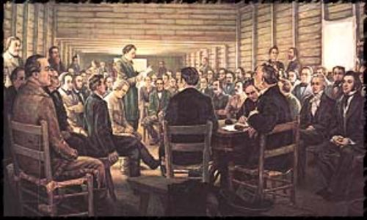
6. A. The Convention of 1836 & Texas Declares Independence March 2nd, 1836
B. The Convention of 1836 met on March 1, 1836 at Washington on the Brazos. George Childress writes the Texas Declaration of Independence, modeling it on the U.S. Declaration of Independence and the delegates signed it on March 2nd.
The first section declares the right of revolution. The second section lists the grievances, or complaints, against the central government. The third section proclaims independence and pledges the support of all who sign the declaration.
Over the next two weeks the delegates wrote the Constitution for the republic of Texas. They also set up a temporary government until elections could be held. David Burnet was selected to be the temporary President of Texas and Lorenzo de Zavala the temporary Vice President. Other important figures were, Samuel Carson Secretary of State, David Thomas Attorney General, Thomas Rusk Secretary of War, Robert Porter Secretary of the Navy, Sam Houston Commander in Chief of the Army

Slide 6
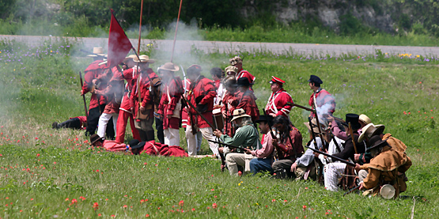
7. A. The Battle of Coleto Creek, March 19, 1836
B. With his wagons broken down General Urrea’s Mexican Army now so close, Fannin could not go to San Antonio. On March 14 Fannin received orders from General Sam Houston to retreat to Victoria, however, remained in Goliad until March 19, waiting for word from King and Ward. During his retreat Fannin stopped in an open prairie near Coleto Creek to give his men and oxen a rest.
General Urrea’s men quickly surrounded the Texans on the prairie. Colonel Fannin’s 400 men, who were outnumbered by Urrea’s troops. Fannin arranged his men in a square to defend themselves from all sides. Urrea ordered several charges, but each time the Texans drove the Mexican troops back. Several Texans, including Fannin, were wounded in the first day of fighting. Early the next morning, Urrea received additional troops.
C. After a brief exchange of fire on the morning of March 20, Fannin surrendered his command. The surviving Texas soldiers were taken captive by the Mexican army and sent to Goliad.

Slide 7
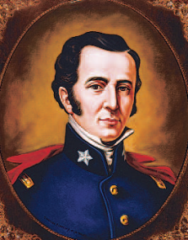
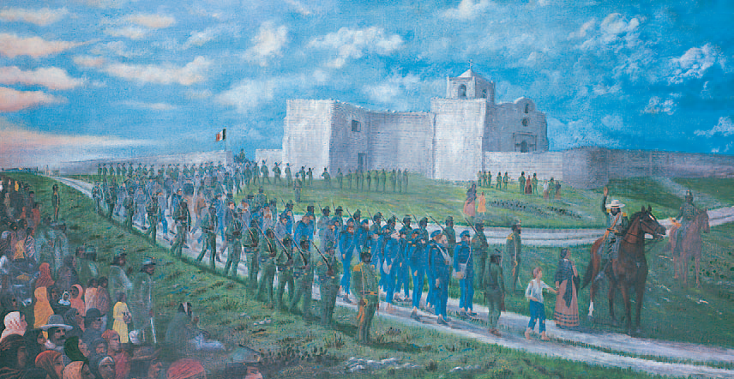
8. A. Massacre at Goliad, March 27,1836
B. Under Col. Fannin, The Texans were marched back to Goliad and held for a week. Santa Anna ordered all Texians executed. On March 27, men who could walk were divided into three columns and marched out of the compound. Some hoped they were being sent home. Instead, the troops began shooting all but a handful who escaped during the confusion. The rest of the men, including Fannin, were executed later. 340-360 men were killed. C. Texans were angry & wanted vengeance for this action.

Slide 8
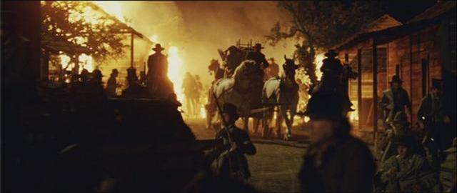
9. A. Houston Assumes Command & The Runaway Scrape, March-April 1836
B. Houston was reappointed commander of the Texas army when the second meeting of the Consultation took place in early March 1836. He arrived in Gonzales on March 11 and found 374 men who had gathered to join the defenders of the Alamo. Deaf Smith returned with Mrs. Susanna Dickinson, her daughter, and Travis’s servant. They reported that all the men at the Alamo had been killed. Texan troops wanted revenge. However, Houston realized his men were not prepared to fight the Mexican army. He needed more time to get his troops ready to go into battle. He ordered Gonzales abandoned and burned. Then he led the men to the east.
Houston and his men camped on Groce family land for about two weeks of training before continuing the retreat to the east. When word of the massacres at the Alamo and at Goliad reached Anglo settlers, they gathered up their belongings and went east as quickly as they could. Some fled all the way to Louisiana. Their flight is known as the Runaway Scrape
No C Needed

Slide 9
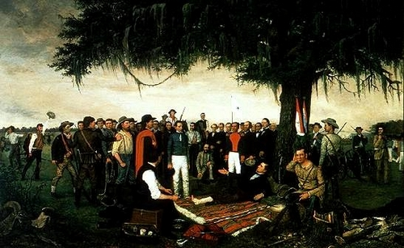
10. A. Battle of San Jacinto April 20th, 1836
B. Sam Houston assumes command of the Texan Army. After the fall of The Alamo, Santa Anna decides to chase Houston’s army into East Texas and splits his Mexican Army into 3 forces.
The Runaway Scrape helped Sam Houston as the Mexicans ran low on rations (food) and equipment.
The Texans scouted Santa Anna’s Army position, and Houston ordered Deaf Smith to burn Vince’s bridge to cut off any Mexican escape route.
While the Mexican Army was resting, at 3pm April 20th, the Texan forces attacked and routed the larger Mexican force in 18 minutes, with cries of Remember the Alamo! Remember Goliad!
C. Santa Anna flees the battlefield, was captured a few days later and eventually signs the Treaties of Velasco making Texas an independent country.

